Slide 1

Using R as a Research Tool.
NERC E3 DTP Training – 28th November
Dr Susan Johnston, Institute of Evolutionary Biology
Demonstrators: Gergana Daskalova, John Godlee

Slide 2
Today’s session:
Write, embed and render code and results into an HTML document.
Carry out basic statistics and visualisations, including:
Chi-squared test with chisq.test()
2-sample t-test with t.test()
Linear regression with lm()

Slide 3
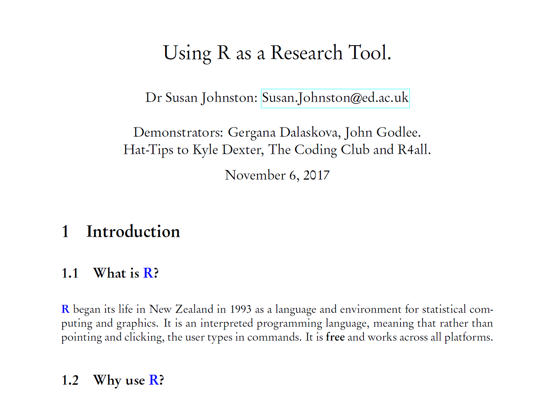
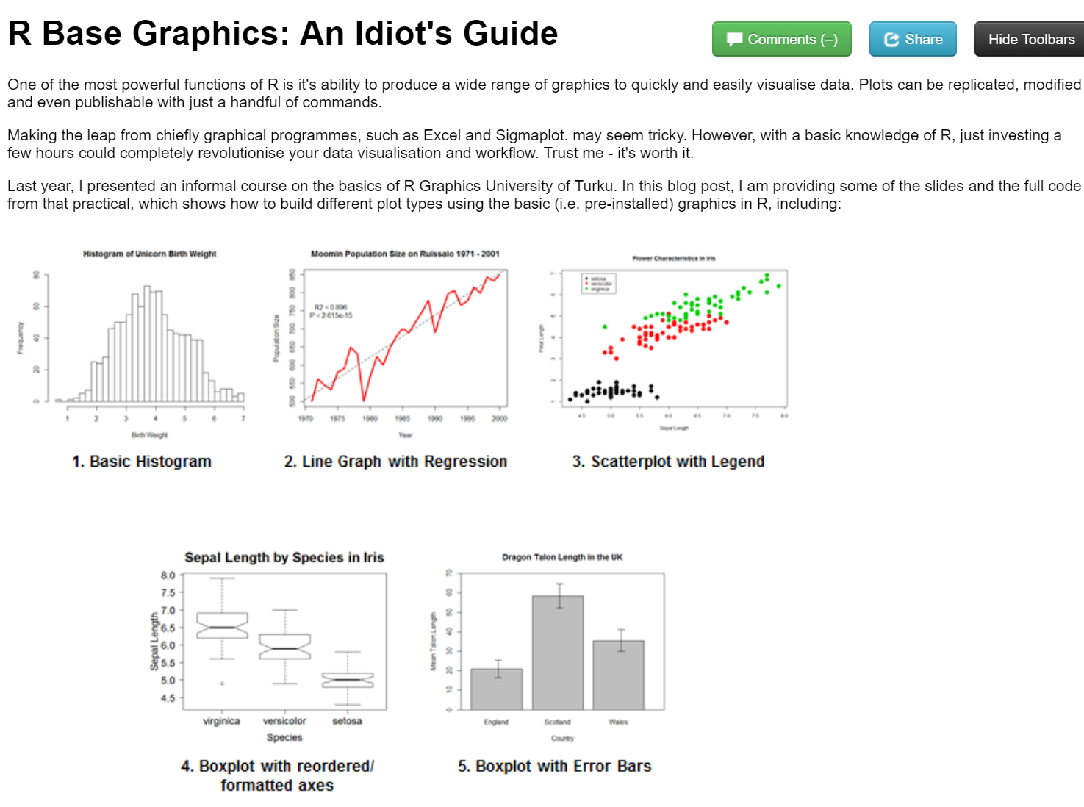
Report writing
LaTeX and R Sweave
knitr to HTML

Slide 4
